Slide 1
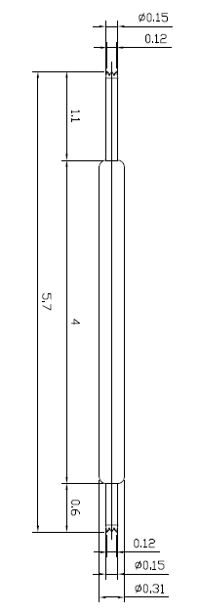
※ General POGO pin – 5.7mm / 0.5P
IVB-DAA-570-031-A046-00
Pitch | 0.5mm
Total Length | 5.7mm
Use Length | 5.2mm
Use Stroke | 0.5mm
Spring Force at Use Stroke | 20gf at 0.5mm Stroke
Operating Temperature | -40 to 150°C
DC Resistance | 85.0mΩ at 0.5mm stroke
Current Rating | 1.0A (Continuous)
Self Inductance | 1.61 nH
Bandwidth @ -1dB | 7.8 GHz
Top Plunger | BeCu / Au over Ni
Bottom Plunger | BeCu / Au over Ni
Barrel | BeCu / Au over Ni
Spring | Stainless Steel / Au
Insertion Life | 100,000 cycles at 0.5mm Stroke

